Slide 1
Doing the Most Good
How and When to Reason about Charity Efficiency
Robin Bergh
Harvard University & Uppsala University

Slide 2

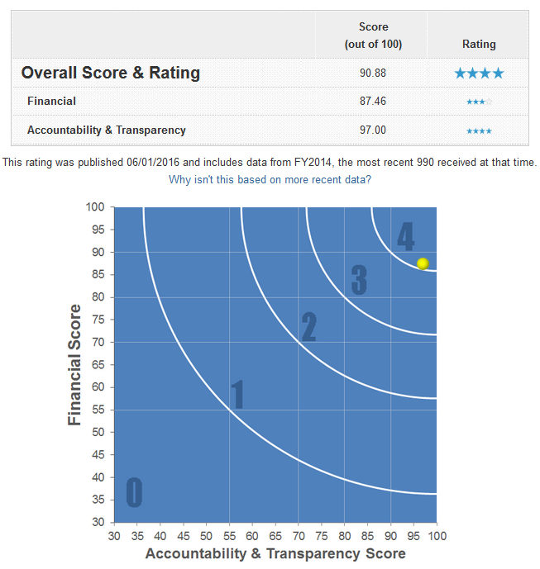
Emotional and Rational Appeals for Donations
Which of the following appeals would you use if you wanted people to donate?
People in Syria need your help.
The life of this child depends on it.
People in Syria need your help.
Many lives depend on it, so we spend your money efficiently.
Please consider a donation to us!
Please consider a donation to us!
Empirical argument:
People help when they are emotionally
(empathically) moved.
Normative argument (effective altruism):
People need to stop acting on irrational gut feelings. They should think rationally about how to do the most good instead.

Slide 3
Charity Efficiency -> Donations?
Does the second appeal work? Does it make people do more good?
“Total good” = donations × internal efficiency × output efficiency
$ × % to program × lives (or DALY/QALY…) per $

Slide 4
Charity Efficiency -> Donations?
Does the second appeal work? Does it make people do more good?
“Total good” = donations × internal efficiency × output efficiency

Slide 5


Charity Efficiency -> Donations?
Does the second appeal work? Does it make people do more good?
“Total good” = donations × internal efficiency × output efficiency
The evidence that efficiency influence donations is mixed (e.g., Bekkers & Wiepking, 2011; Frumkin & Kim, 2001; Karlan & Wood, 2014).
Challenges: Confounds (e.g., organization popularity), reverse causality (I donated to X -> X must be good!), compliance pressure on previous donors & ecological validity.
And… What happens when we combine emotional and reasoning appeals?
People in Syria need your help.
The life of this child depends on it.
People in Syria need your help.
Many lives depend on it, so we spend your money efficiently.
Please consider a donation to us!
Please consider a donation to us!

Slide 6
Spontaneous Emotions and Deliberation: Dual-Process Perspectives
What happens when we combine emotional and reasoning appeals?
Some research suggest that people withhold donations when they engage in deliberate thinking (Small et al., 2007).
Dual process models of prosocial behaviors:
Emotional
(empathic) reactions
Giving

Slide 7
Spontaneous Emotions and Deliberation: Dual-Process Perspectives
What happens when we combine emotional and reasoning appeals?
Some research suggest that people withhold donations when they engage in deliberate thinking (Small et al., 2007).
Dual process models of helping:
Emotional
(empathic) reactions
Deliberation
Giving

Slide 8
Spontaneous Emotions and Deliberation: Dual-Process Perspectives
What happens when we combine emotional and reasoning appeals?
Some research suggest that people withhold donations when they engage in deliberate thinking (Small et al., 2007).
Dual process models of helping:
System I
Heuristic
processing (fast)
Spontaneous
generosity
System II
Deliberation (slow)
Thoughtful giving /“Calculated greed”

Slide 9
Current Working Model
System I
Empathy trigger
commitment (yes/no)
Donate: Yes/No
System II
Efficiency
(“constructive analyzing”)
Donated amounts

Slide 10




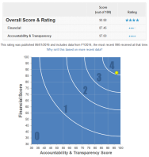
Experimental Design
Efficiency information
No
Yes
Image
Yes
No
Commit yes/no
Donate
Commit yes/no
Donate

Slide 11
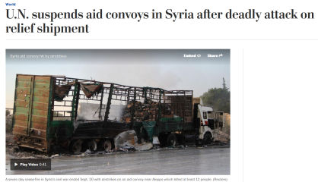
Experimental Design
Participants from Amazon Mechanical Turk, N = 398-614 per study (~ 50/cell)
Baseline payment of $1-3, and a bonus from which they could donate
($3 in Study 1-2, raffle for $50 in studies 3-4).
Efficiency information
No
Positive
Negative
Image
Yes
No

Slide 12


Results: Study 1-3
Commit yes/no
Donate
Experiment 1
Commit yes/no
Donate
Experiment 2
Experiment 3

Slide 13
Results: Study 1-3
Commit yes/no
Donate
Experiment1
Image
Donated: No (0) / Yes (>0)
Efficiency
Image × Efficiency
Donated amount

Slide 14
Results: Study 1-3
Commit yes/no
Donate
Experiment 2
Image
Donated: No (0) / Yes (>0)
Efficiency
Image × Efficiency
Donated amount
Experiment 3
Image
Donated: No (0) / Yes (>0)
Neg. efficiency
Image × Pos. efficiency
Donated amount

Slide 15
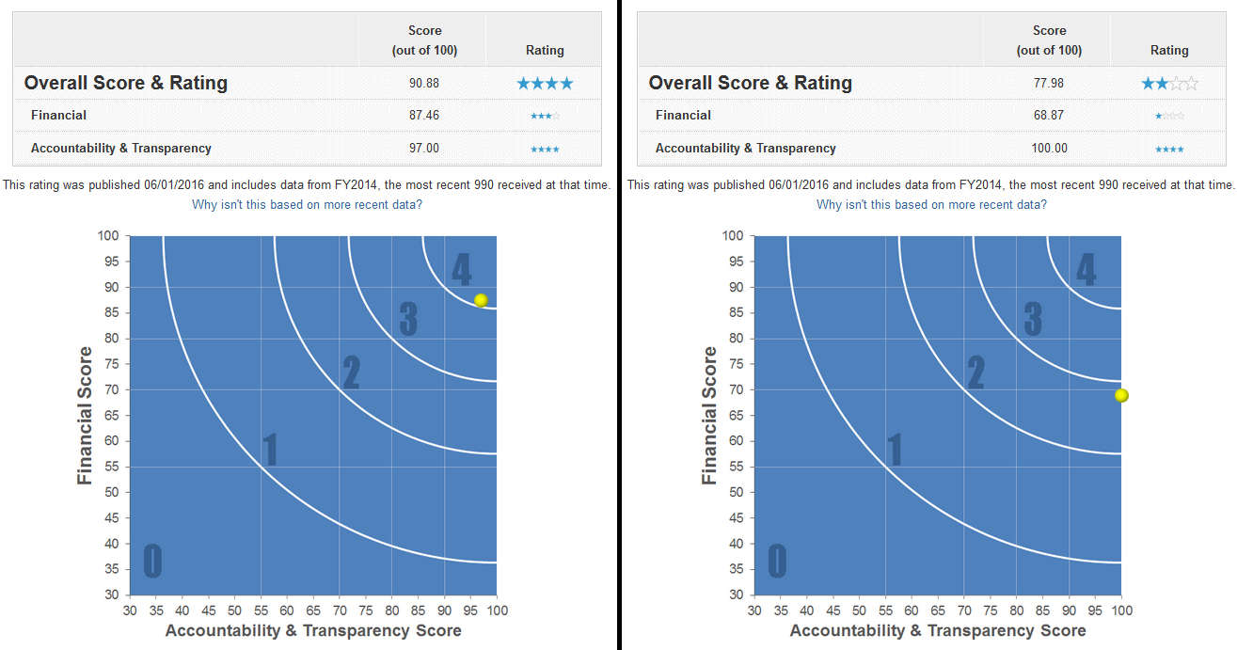
A Couple of Noteworthy Limitations…
The effect of timing is observed across experiments, not within (i.e. non-randomized)
Perhaps efficiency is inherently comparative and difficult to evaluate on its own, hence only meaningful in conjoint evaluation (see Hsee et al., 1999).
Commit yes/no
Donate
Randomization
Commit yes/no
Donate

Slide 16
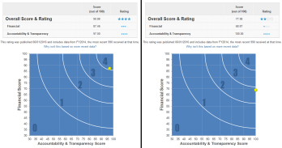

Experimental Design Study 4
Efficiency comparison
Early
None
Late
->Y/N
Y/N
Y/N ->
Image
Yes
No
->Y/N
->Y/N
Y/N ->

Slide 17
Results Study 4
As before, any engagement with efficiency information suppresses the image effect.

Slide 18
Results Study 4
But… timing does matter in subtler ways.
Image
Early efficiency comparison
Donated: No (0) / Yes (>0)
Late efficiency comparison
Image × Early efficiency
Donated amount
Image × Late efficiency

Slide 19
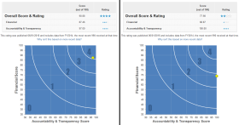
Results Study 4
Do people choose the efficient charity, and does the percentage vary as a function of the manipulations?
Efficiency comparison
Early
None
Late
90%
88%
Image
Yes
No
72%
87%
->Y/N
Poor
decision-making…

Slide 20
Summary & Conclusions
Efficiency deliberation can interfere with emotional appeals, leading to 20-25% less donations.
But most importantly: The “collision” between emotional and rational efficiency appeals may depend on when the latter is introduced.
Practical implication to maximize donations and their impact:
Open questions: Are the psychological mechanisms different when people seek out charities themselves online (Meer, 2017)?
Are big and small donations differently influenced by efficiency concerns (Levin et al., 2016)?
Y/N
More donations &
“better” donations

Slide 21


Thanks to…
Thank you for your attention!
Sarah Cotterill
Harvard University
Swedish Research Council

